Slide 1

E-Commerce Database System
Punith Giridhar - 001347542
Shivam Verma - 001344145
Kaushik Patil - 001056490

Slide 2

Objectives
In this project we are designing and managing an E-Commerce database that helps the Director of Supply Chain and Business Operations of the company to address problems and take strategic business decisions with respect to
Inventory Control
Customer Satisfaction
Real time product stock information
Order management
Supplier management
On-time delivery performance
Employee Responsibility

Slide 3
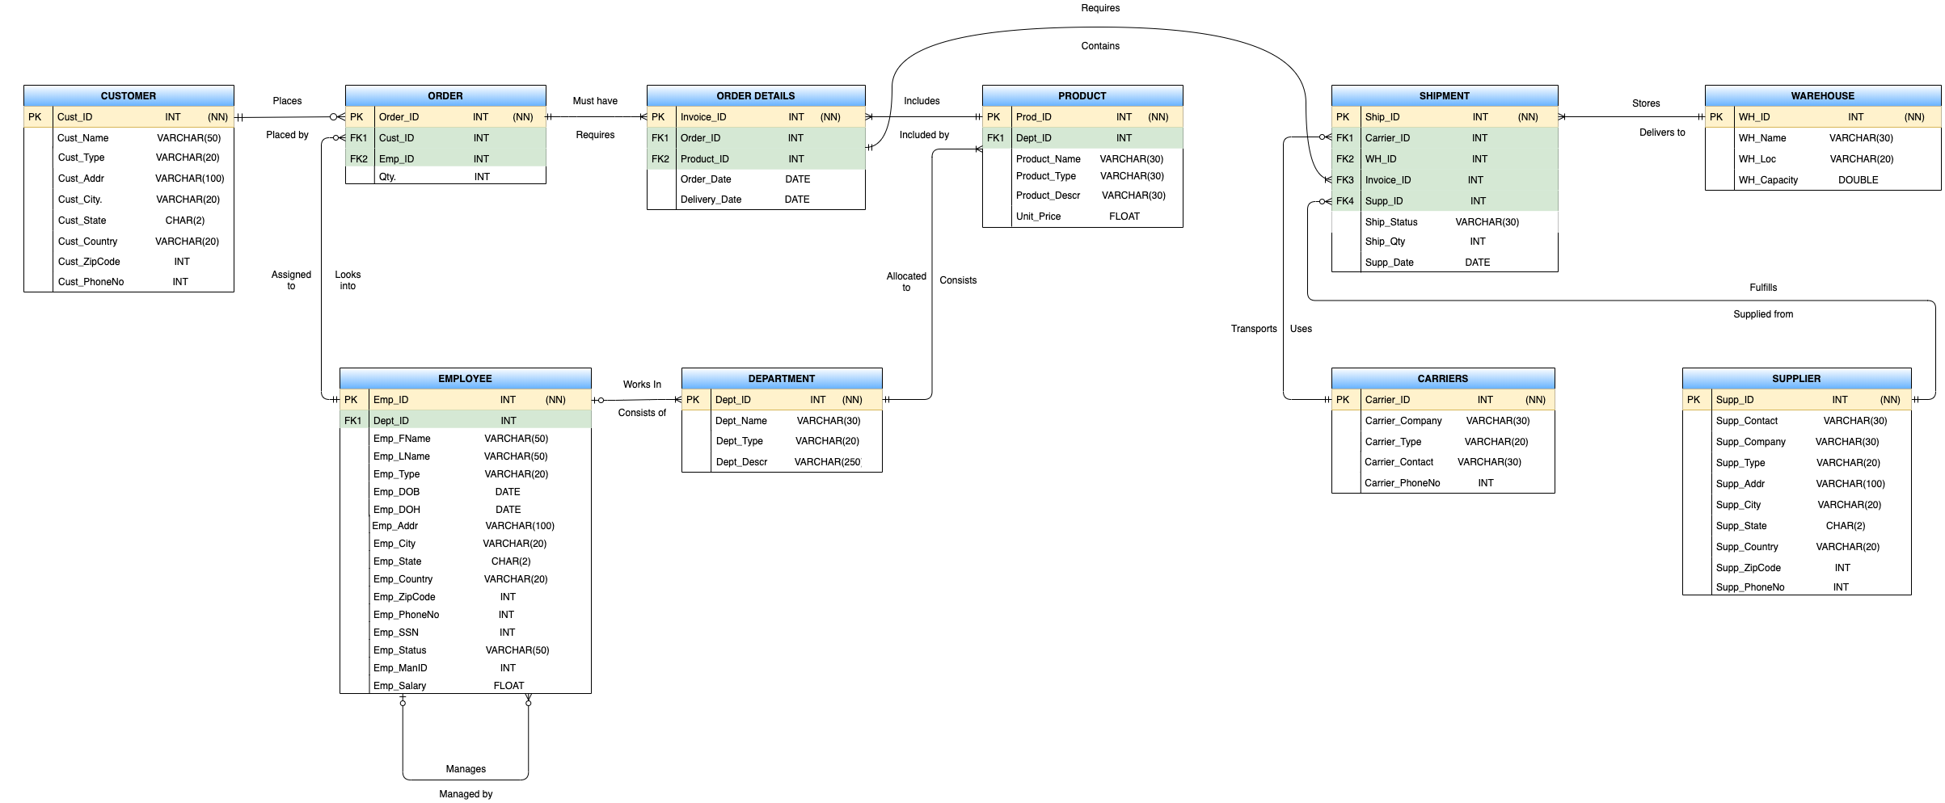
ER Diagram

Slide 4

DDL
Create Table Commands

Slide 5
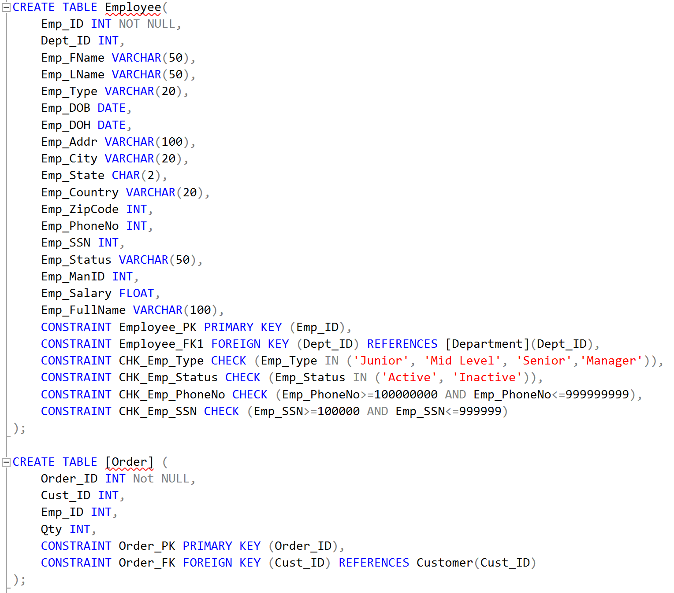
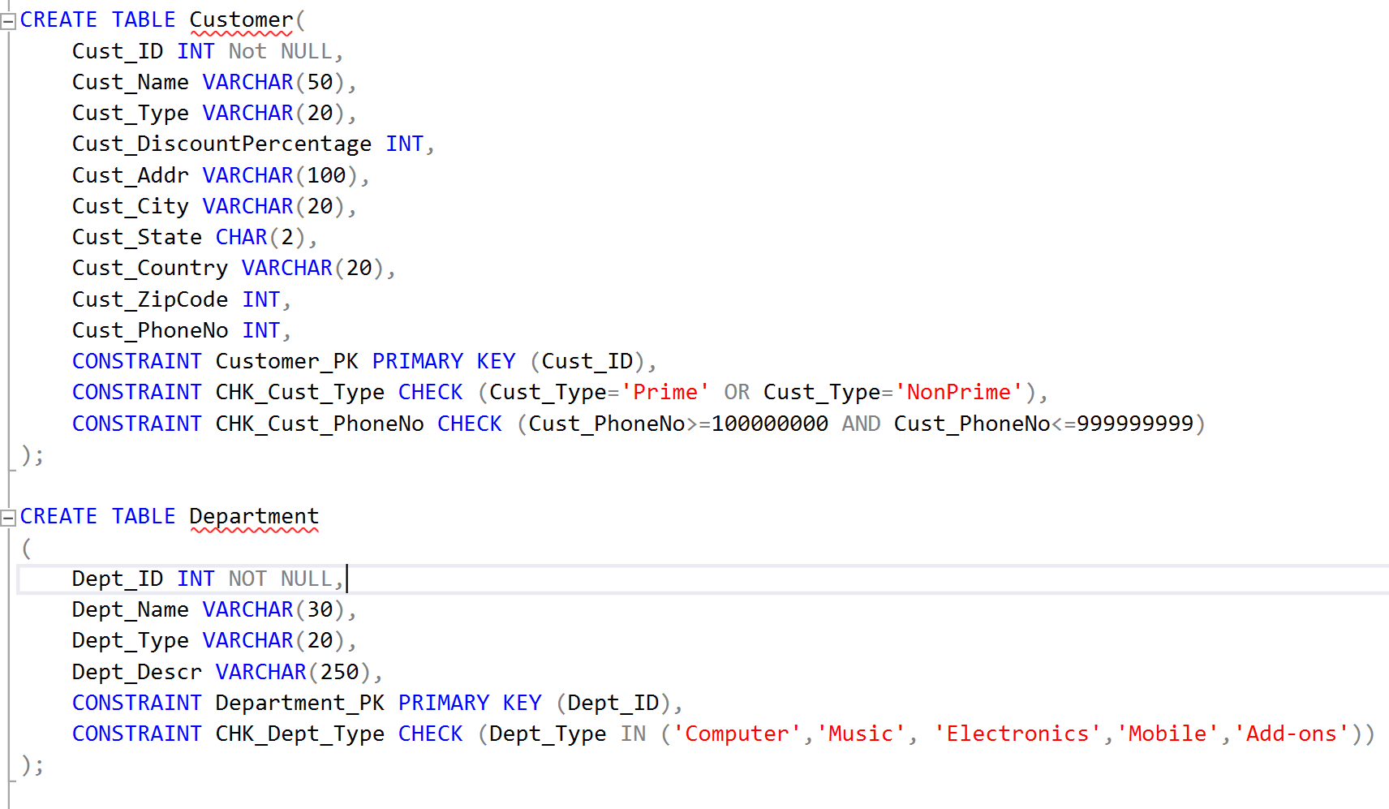

Slide 6
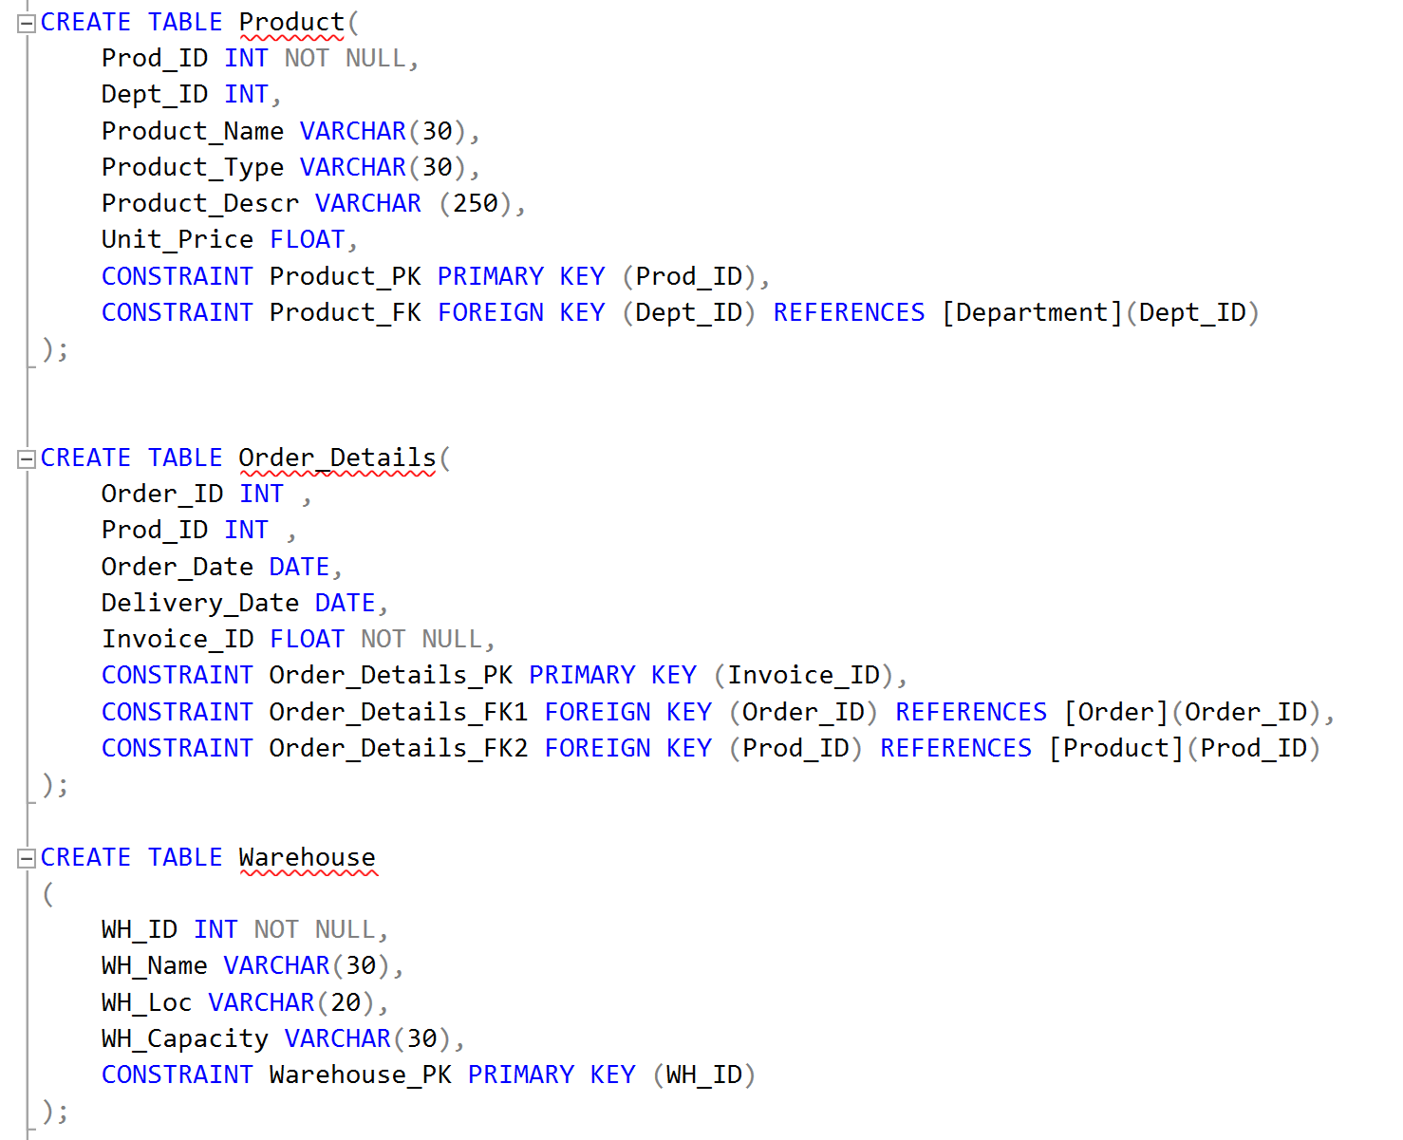
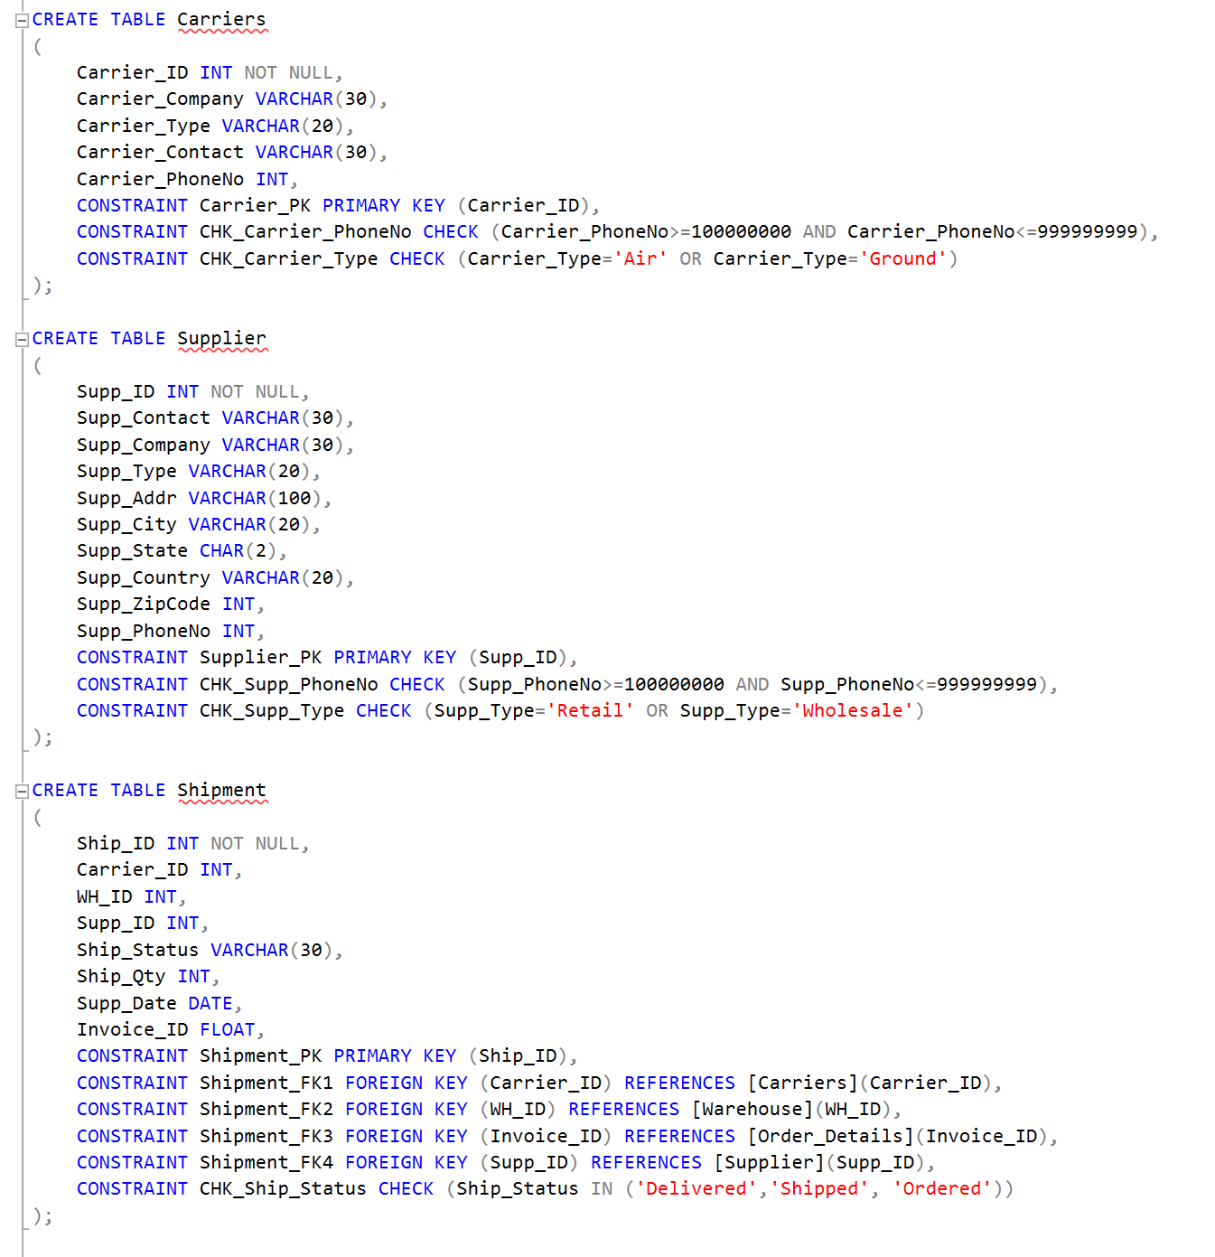
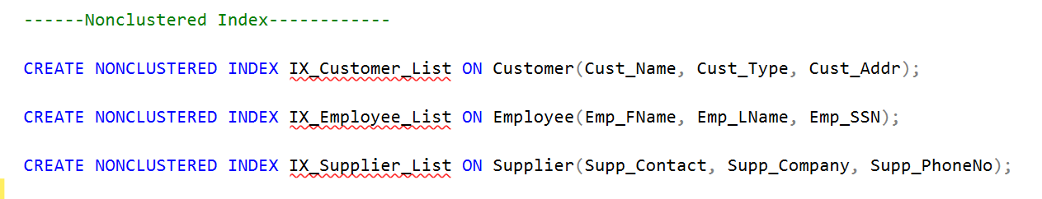

Slide 7
DML
Insert Commands

Slide 8
Customer
INSERT INTO Customer(Cust_ID, Cust_Name, Cust_Type, Cust_Addr, Cust_City, Cust_State, Cust_Country, Cust_ZipCode, Cust_PhoneNo)
VALUES(10001, 'Aristotle Bradley', 'Prime', '842-7950 Egestas. Av.', 'Boston', 'MA', 'USA', 171781, 588281779);
Order
INSERT INTO [Order](Order_ID, Cust_ID, Emp_ID, Qty) VALUES(9000001, 10001, 7001, 3);
Order Details
INSERT INTO Order_Details(Order_ID, Prod_ID, Order_Date, Delivery_Date, Invoice_ID)
VALUES(9000001, 5000001, '01/13/2020', '01/18/2020', 90000015000001);
Employee
INSERT INTO Employee(Emp_ID, Dept_ID, Emp_FName, Emp_LName, Emp_Type, Emp_DOB, Emp_DOH, Emp_Addr, Emp_City, Emp_State, Emp_Country, Emp_ZipCode, Emp_PhoneNo, Emp_SSN, Emp_Status, Emp_ManID, Emp_Salary)
VALUES(7001, 111, 'Luke', 'Burt', 'Mid Level', '06/21/1993', '03/26/2015', 'P.O. Box 599, 9899 Ligula. Avenue', 'Los Angeles', 'CA', 'USA', 784458, 610196456, 284071, 'Active', 7013, 75000);
Department
INSERT INTO Department(Dept_ID, Dept_Name, Dept_Type, Dept_Descr)
VALUES(111, 'Laptops', 'Computer', 'You can find different laptop models here');

Slide 9
Shipment
INSERT INTO Shipment(Ship_ID, Carrier_ID, WH_ID, Supp_ID, Ship_Status, Ship_Qty, Supp_Date, Invoice_ID)
VALUES(200001, 100, 10, 500, 'Delivered', 3, '01/16/2020', 90000015000001);
Product
INSERT INTO Product(Prod_ID, Dept_ID, Product_Name, Product_Type, Product_Descr, Unit_Price)
VALUES(5000001, 111, 'HP Spectre Laptop', 'Laptops', 'Buy this amazing laptop on sale', 1300);
Supplier
INSERT INTO Supplier(Supp_ID, Supp_Contact, Supp_Company, Supp_Type, Supp_Addr, Supp_City, Supp_State, Supp_Country, Supp_ZipCode, Supp_PhoneNo)
VALUES(500, 'Alvin Bender', 'Samsung', 'Retail', 'Apt604-3722 Nullam St.', 'Newark', 'DE', 'United States', 51272, 347255775);
Warehouse
INSERT INTO Warehouse(WH_ID, WH_Name, WH_Loc, WH_Capacity)
VALUES(10, 'BO15', 'Boston', '10000 units');
Carriers
INSERT INTO Carriers(Carrier_ID, Carrier_Company, Carrier_Type, Carrier_Contact, Carrier_PhoneNo)
VALUES(100, 'UPS', 'Air', 'Tyler Forbes', 626880514);

Slide 10
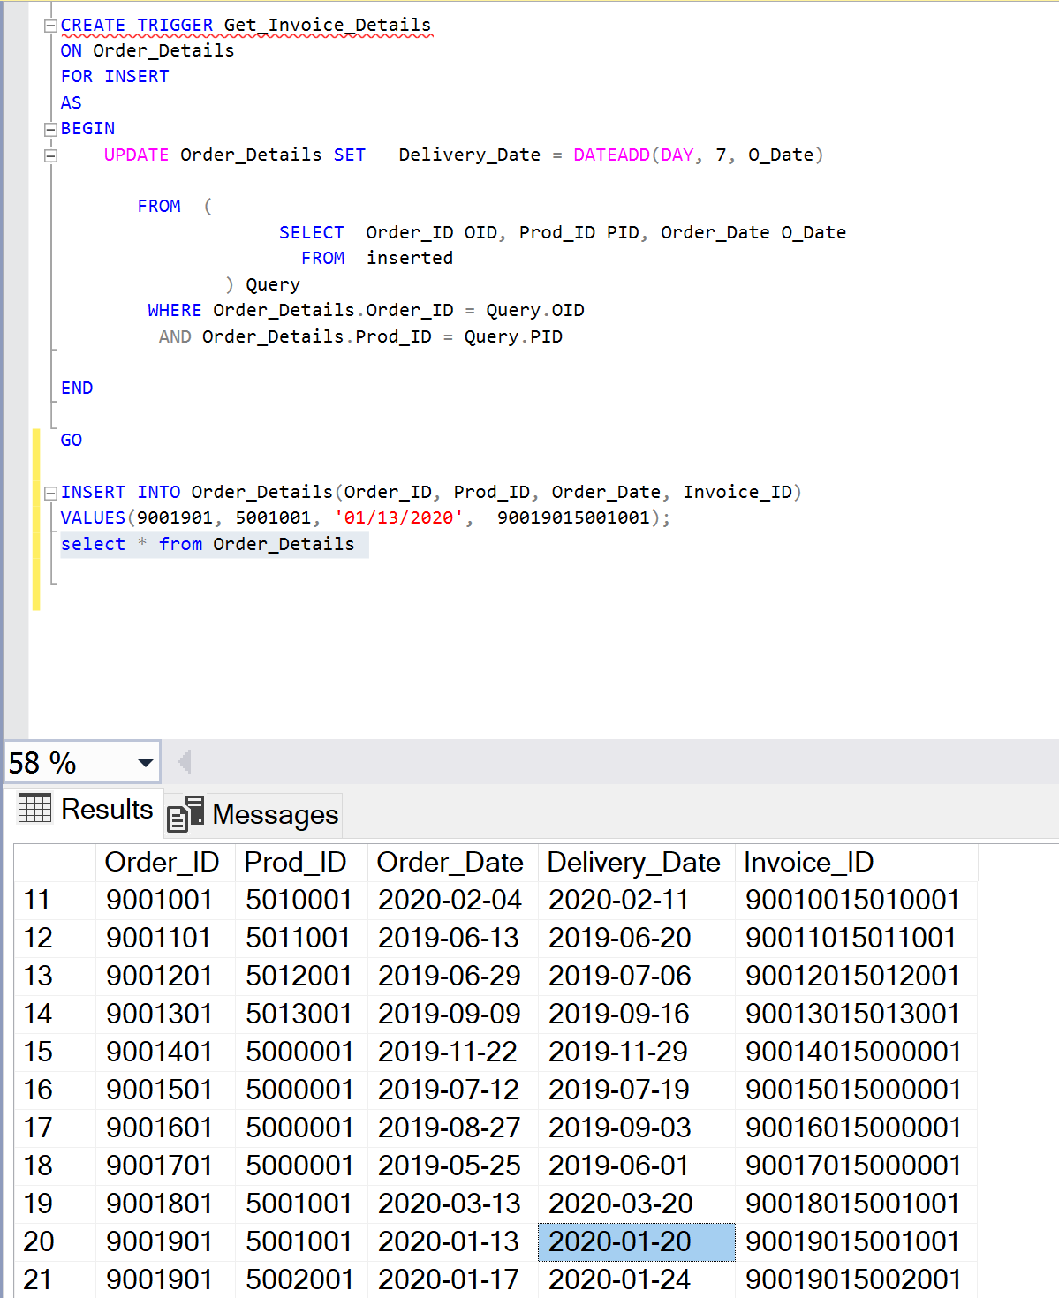
Trigger

Slide 11
Views

Slide 12
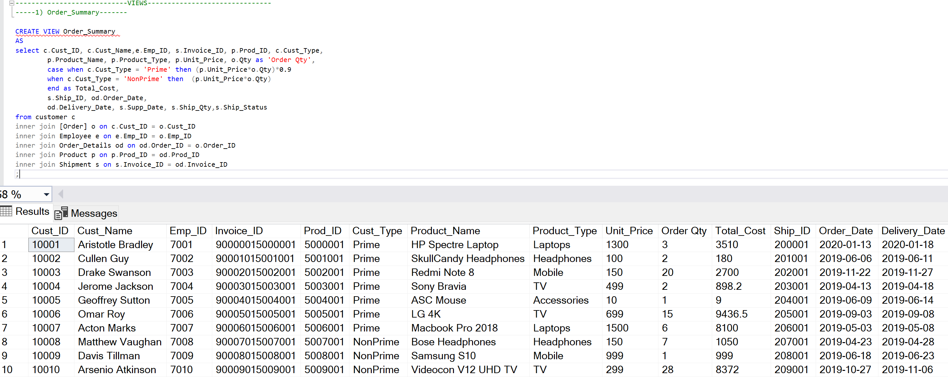
Order Summary

Slide 13
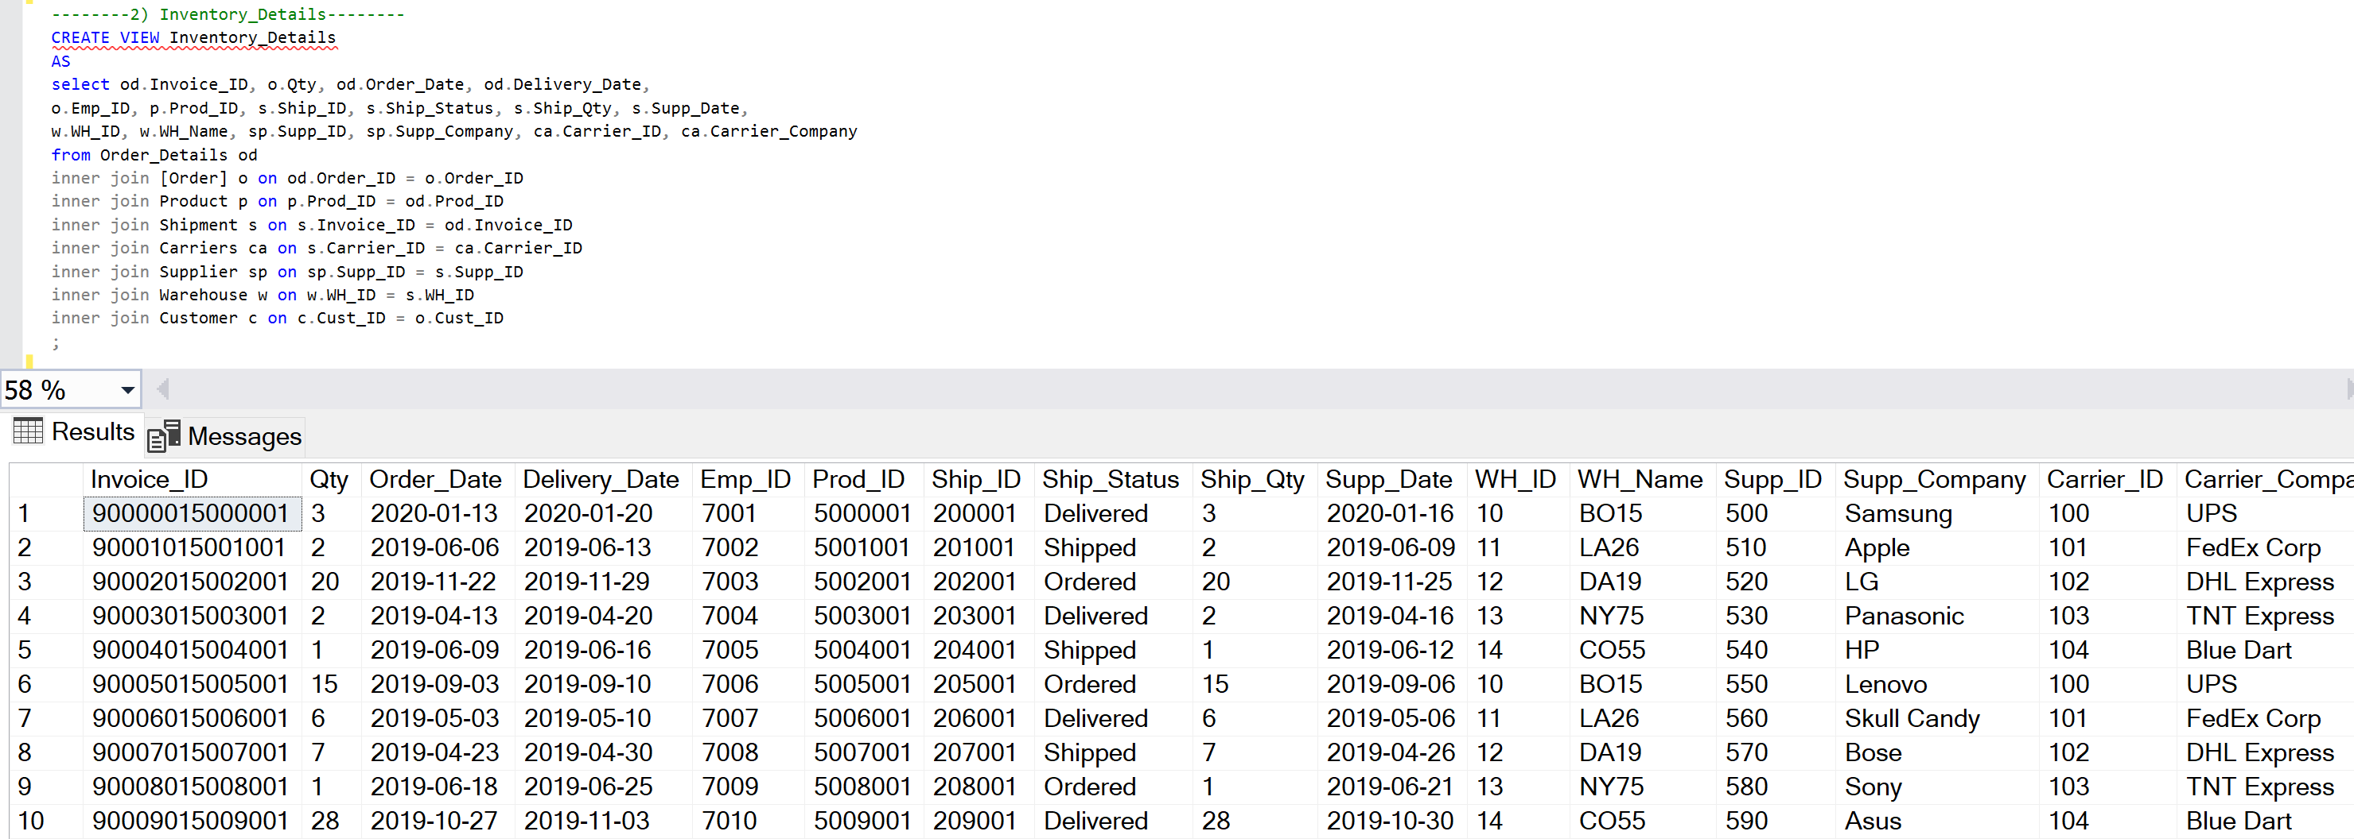
Inventory Details

Slide 14
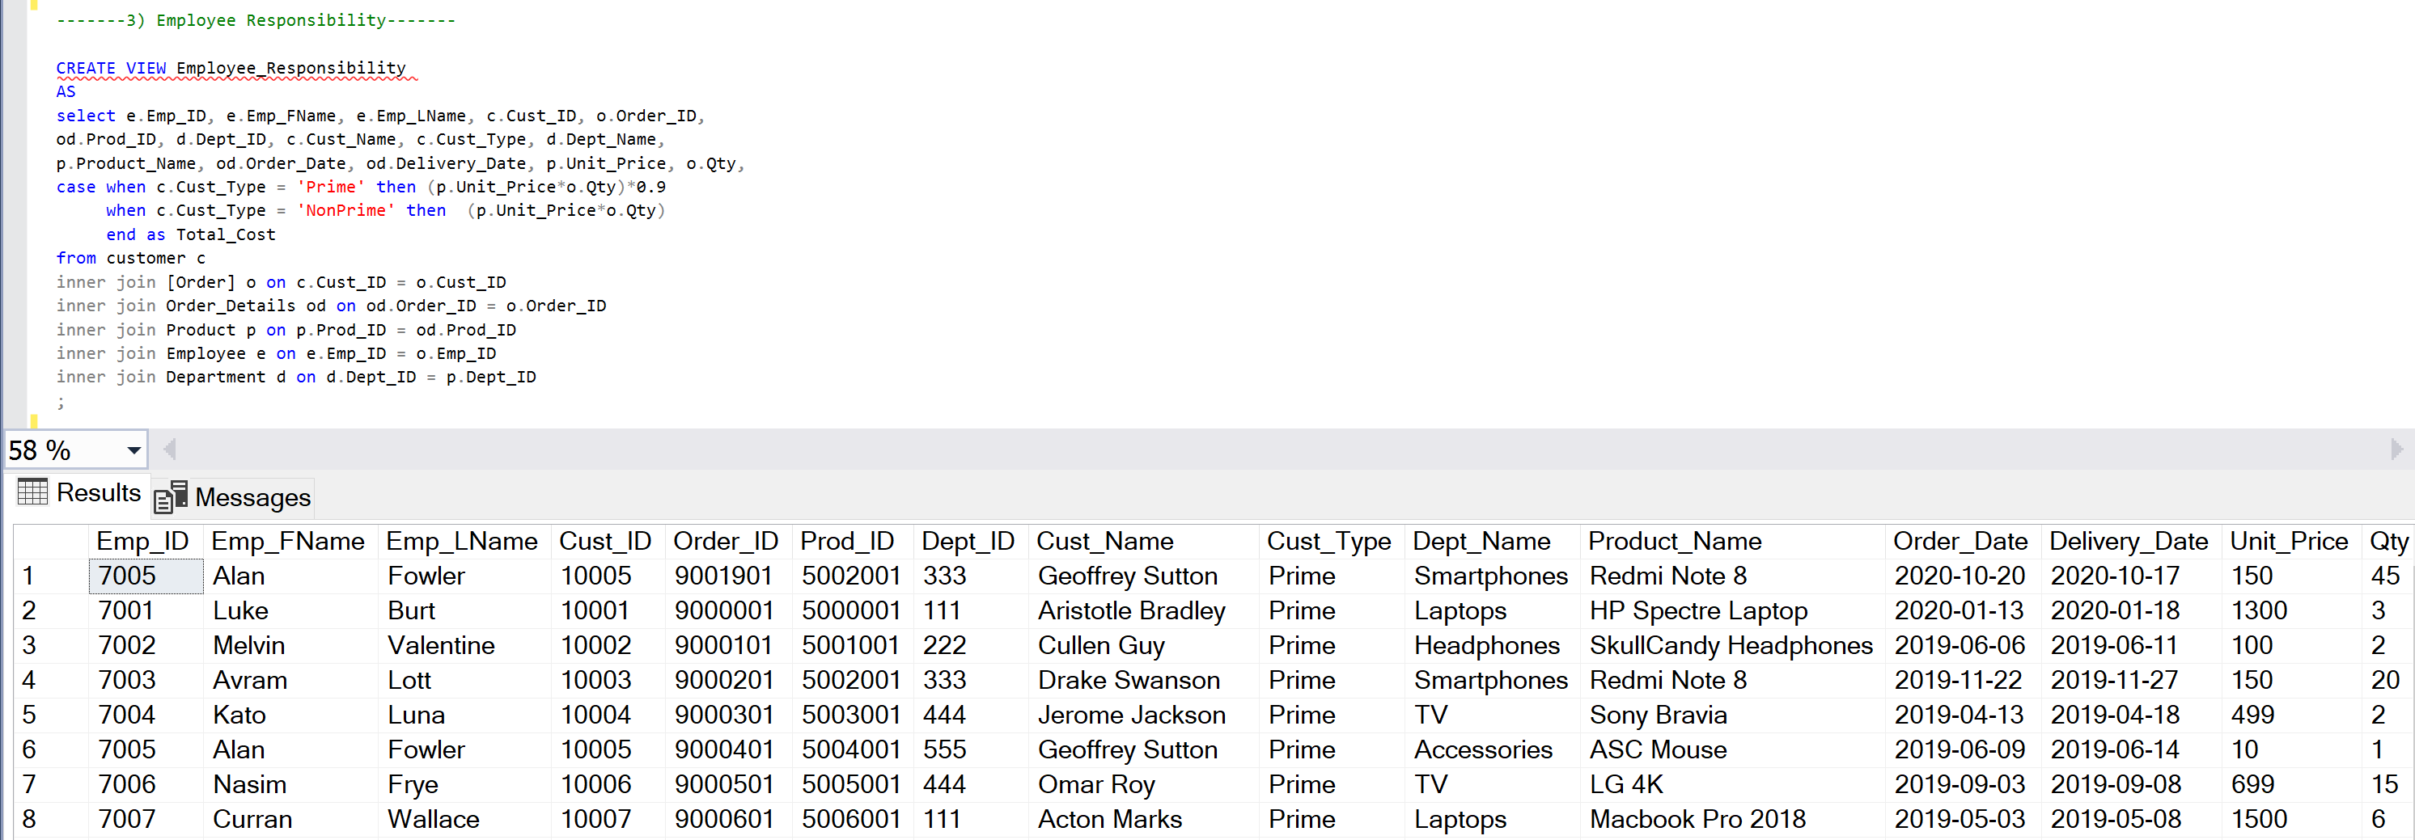
Employee Responsibility

Slide 15
Stored Procedures

Slide 16
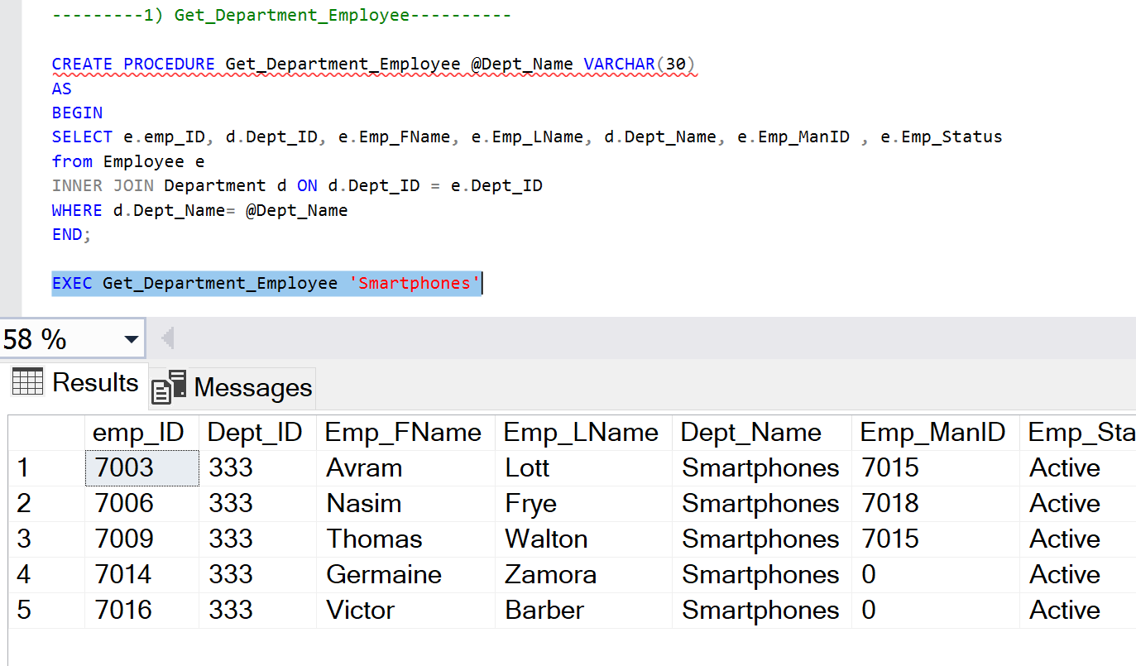
Get_Department_Employee

Slide 17
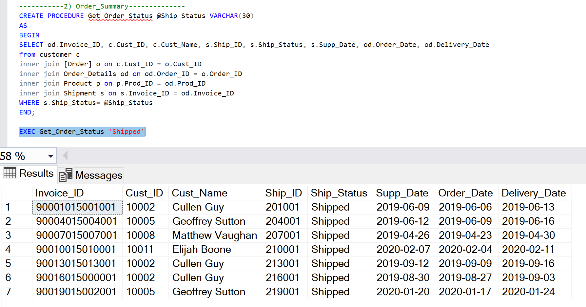
Order_Summary

Slide 18
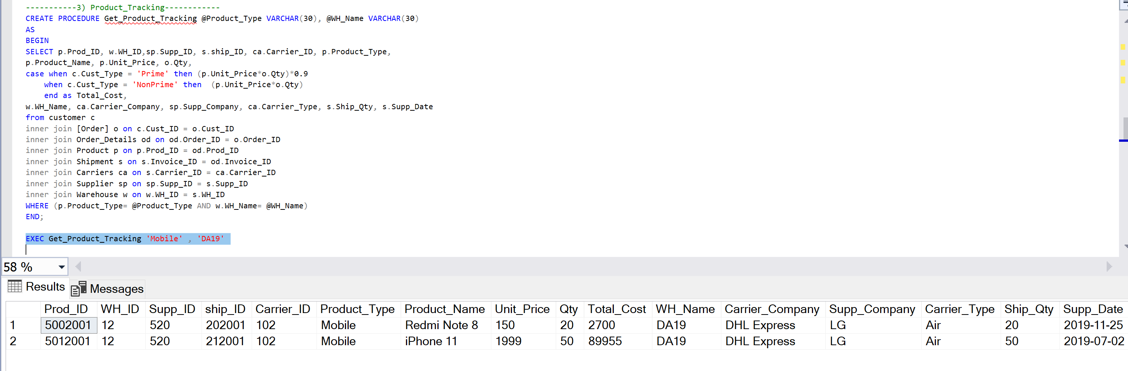
Product_Tracking

Slide 19
User Defined Functions

Slide 20
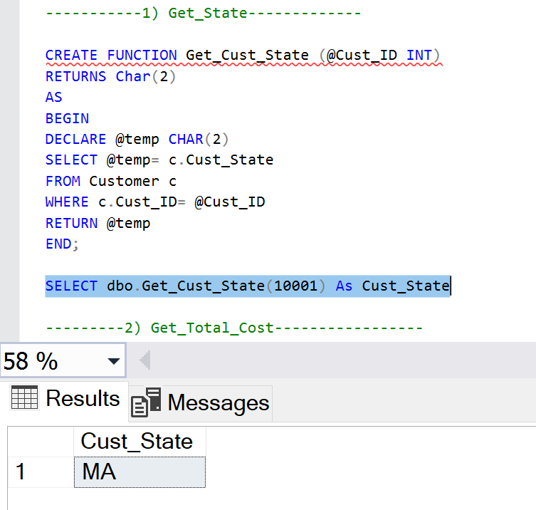
Get_State

Slide 21
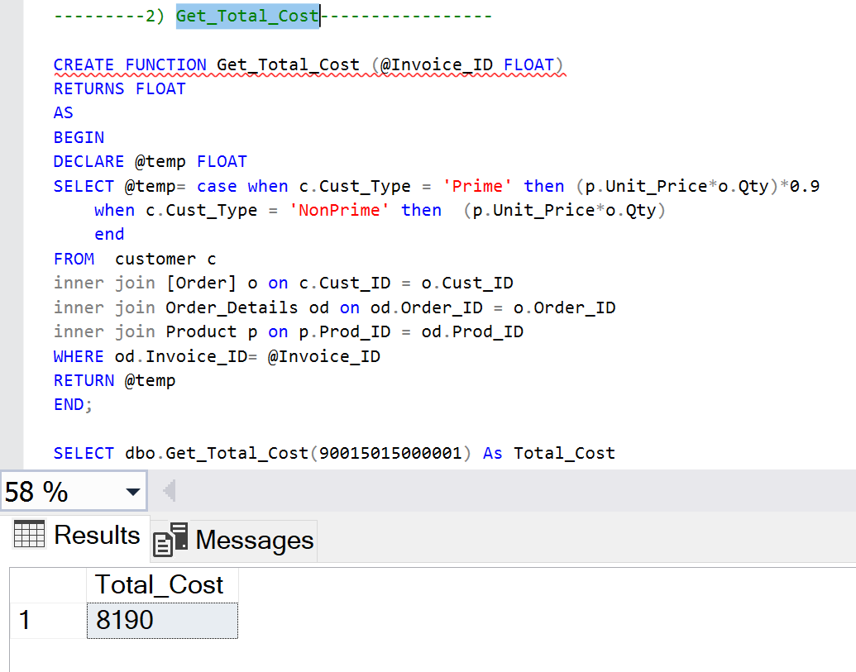
Get_Total_Cost

Slide 22
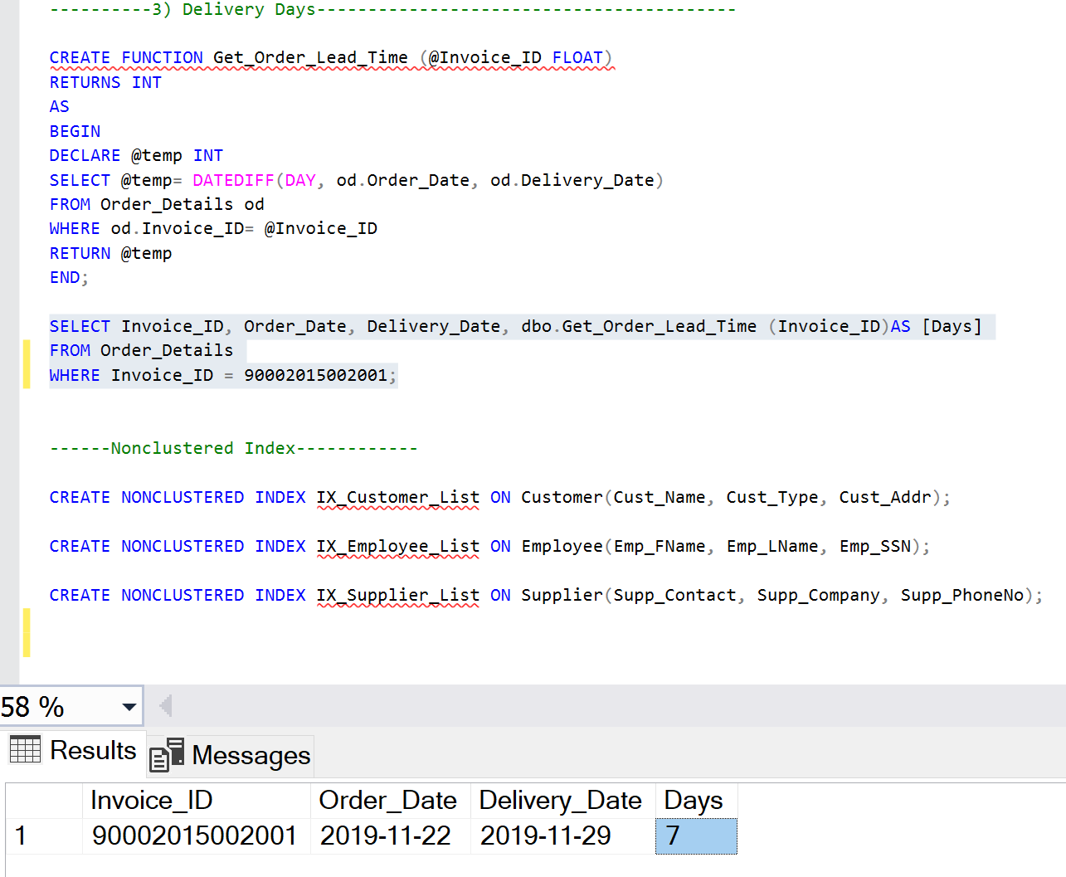
Get_Order_Lead_Time

Slide 23

Data Report in Tableau

Slide 24
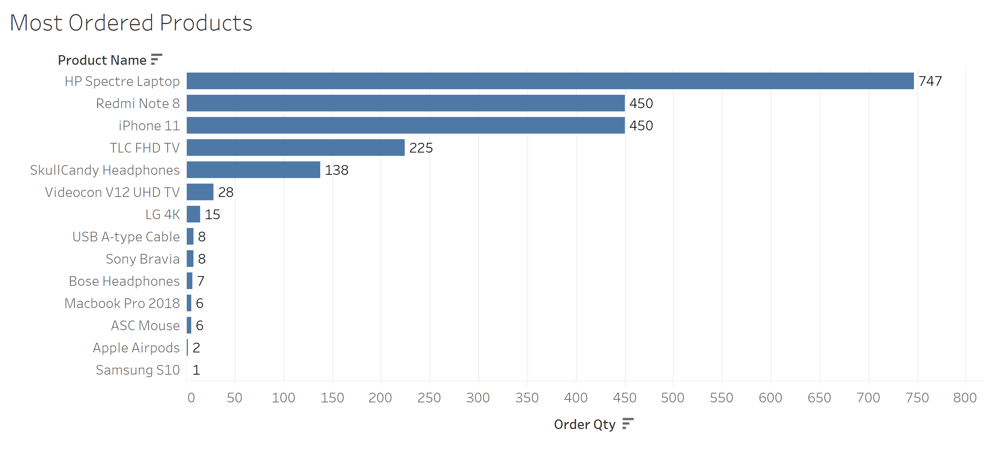

Slide 25
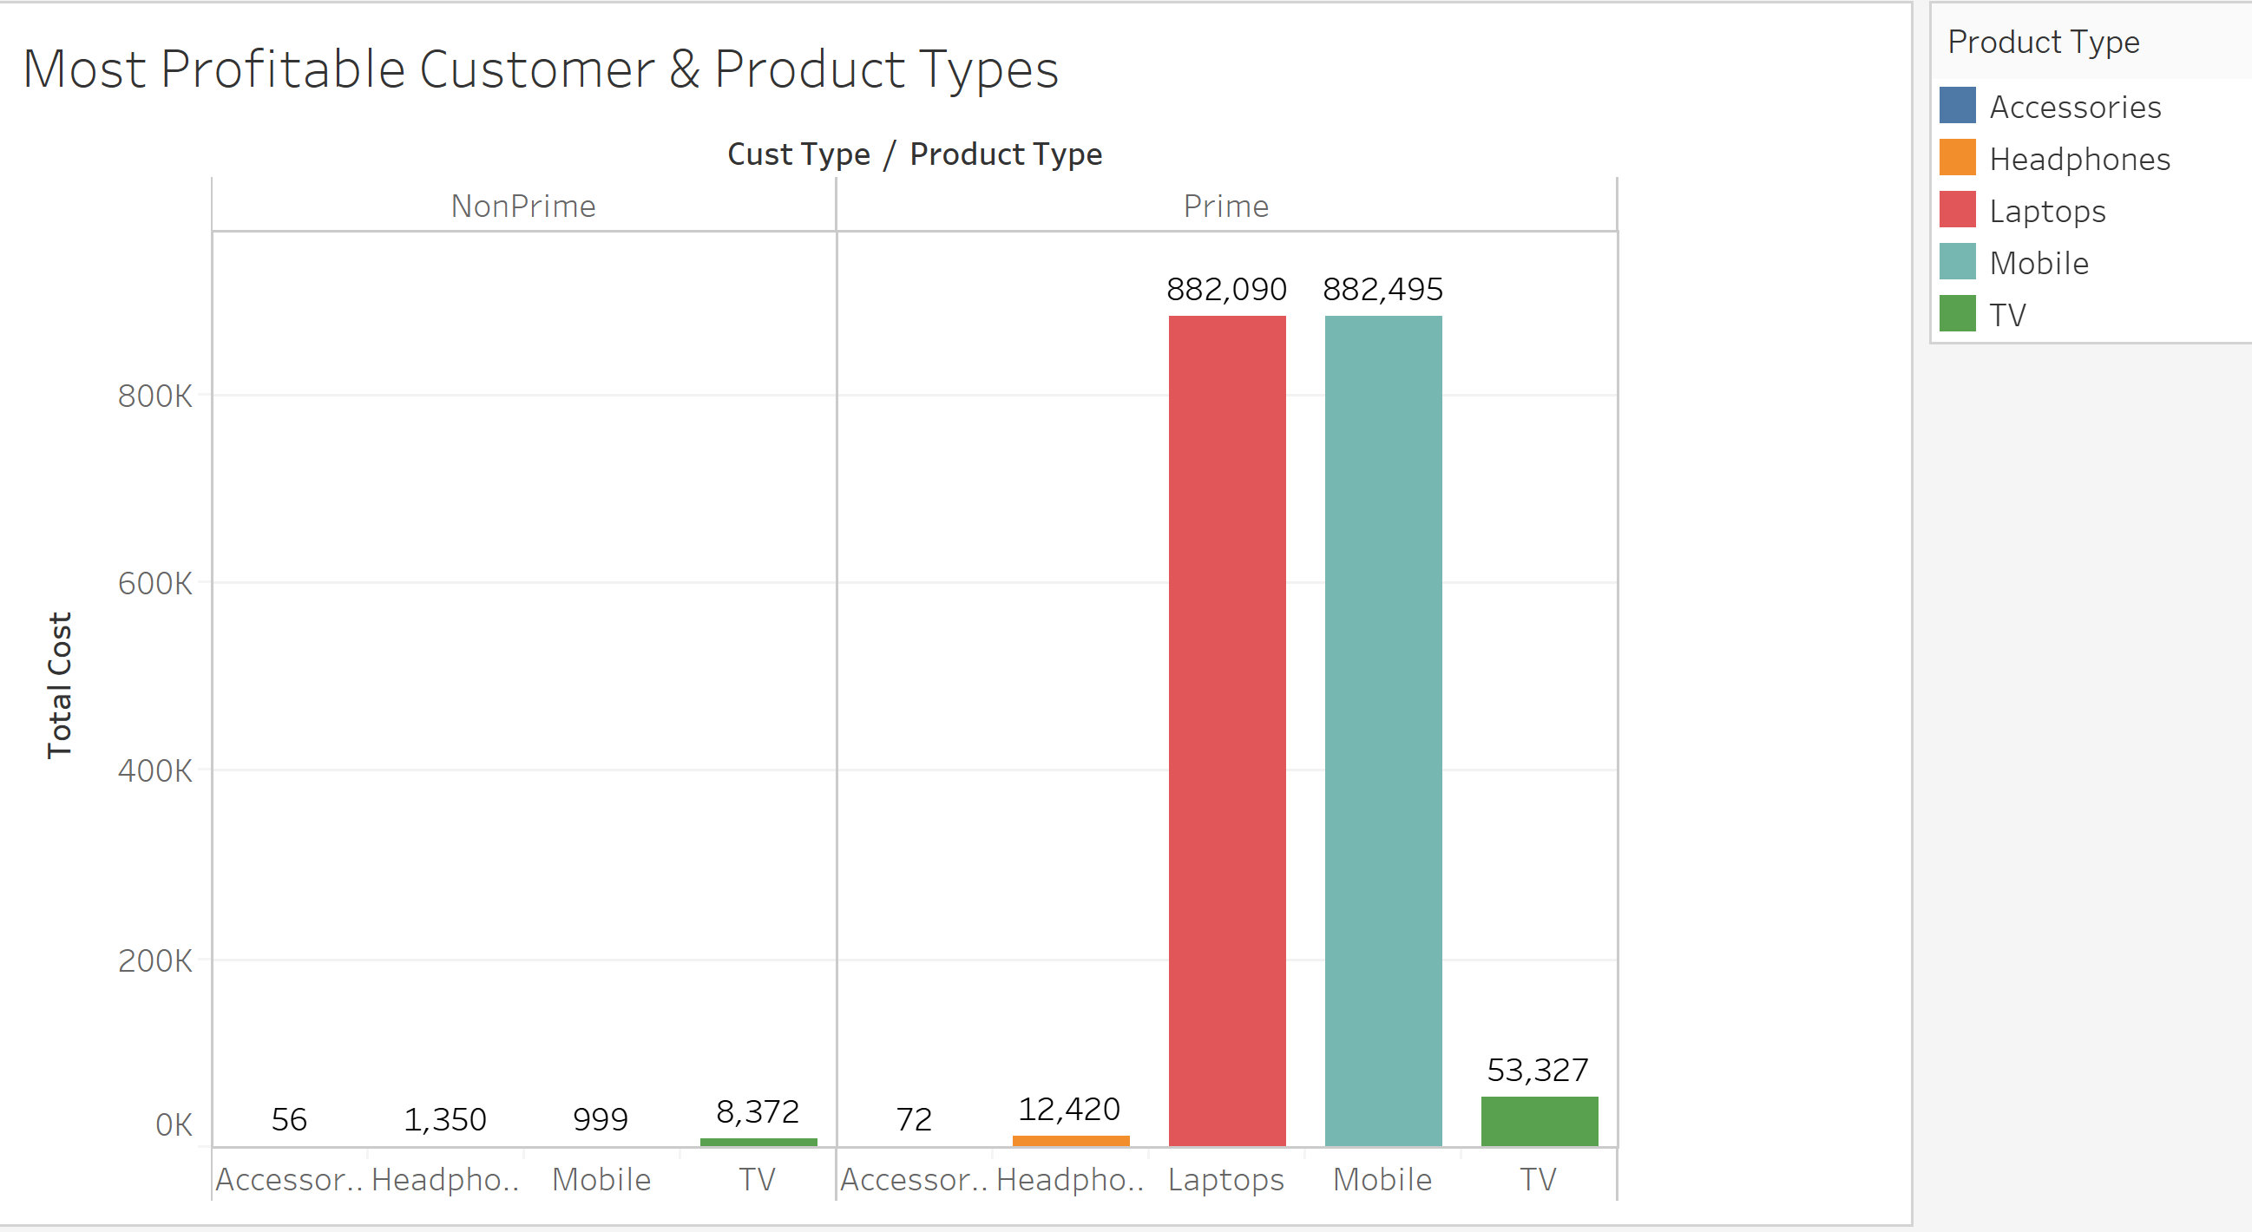

Slide 26
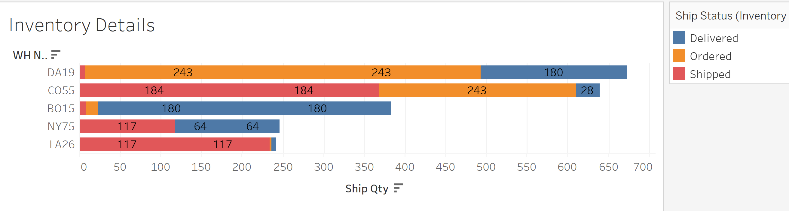

Slide 27
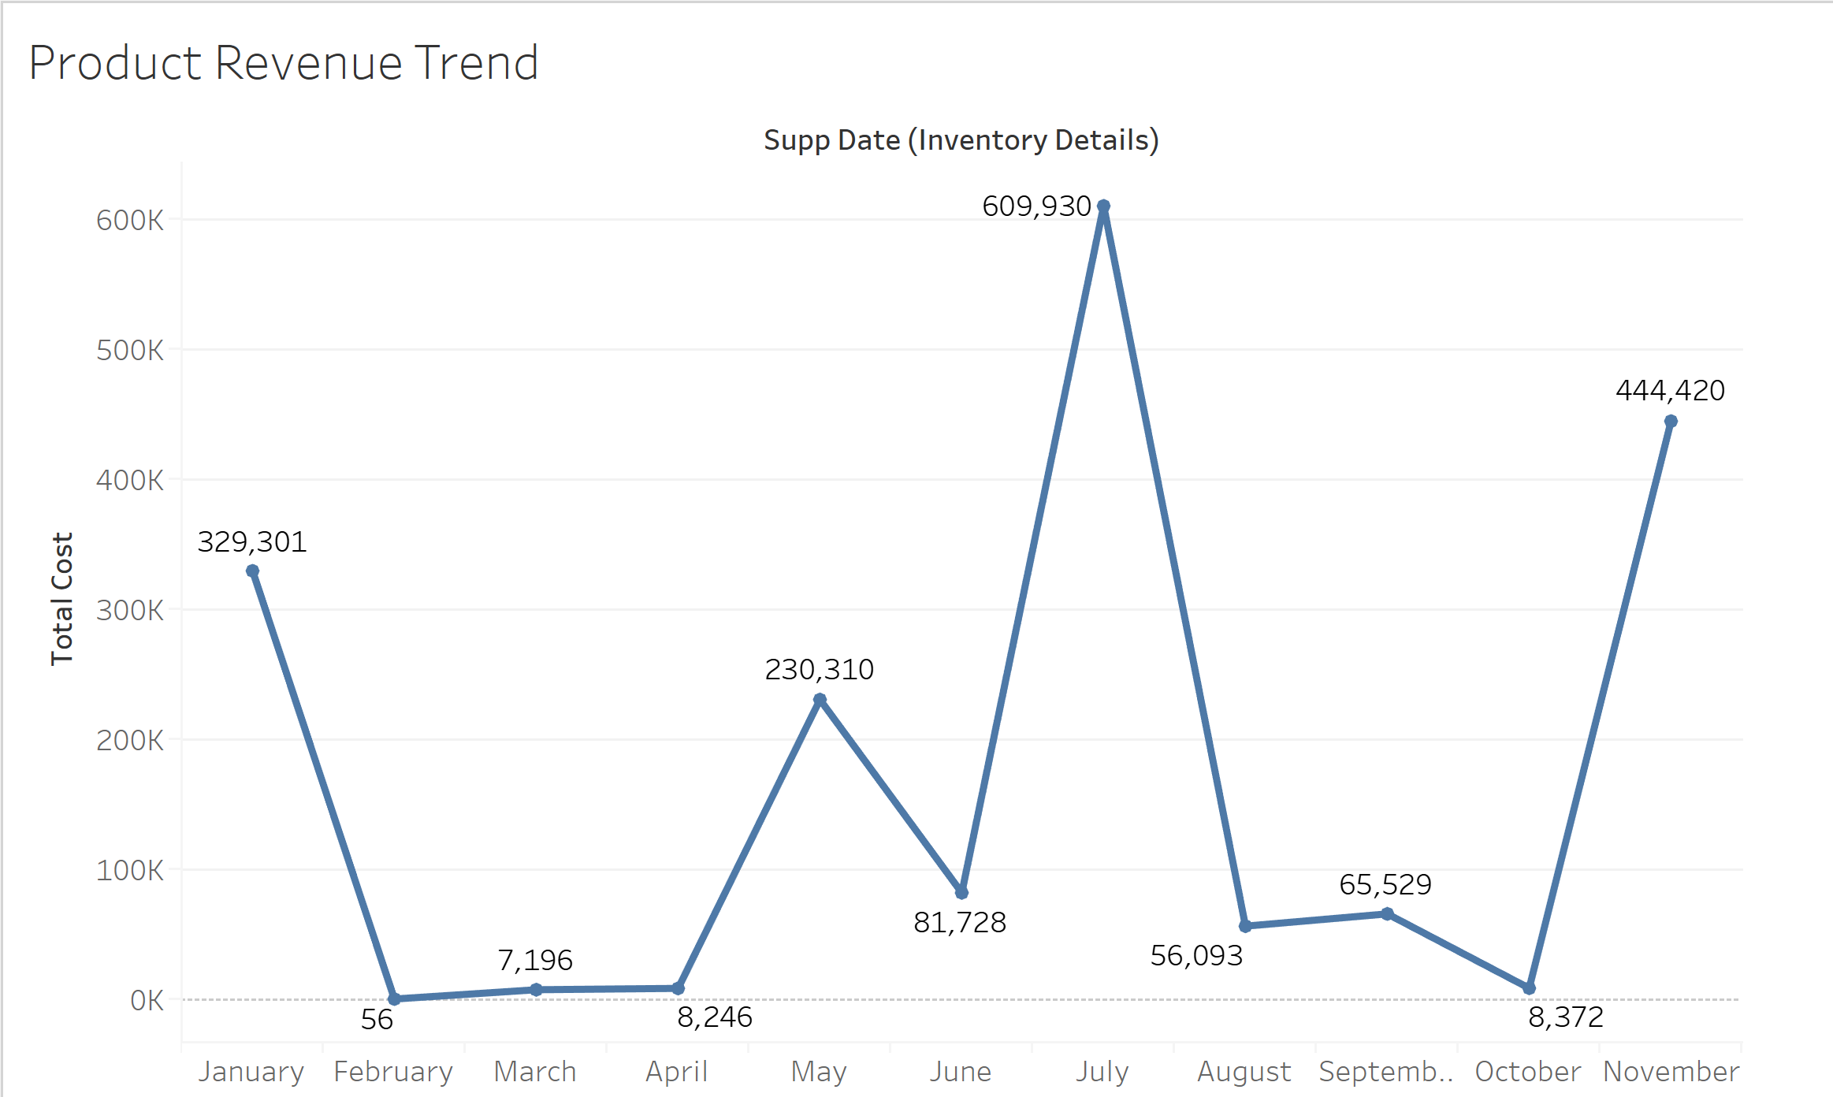

Slide 28
THANK YOU!

